Slide 2

An Intelligent Approach for
Oral Cancer Diagnosis
Supervised by
Prof. Hazem ElBakry

Slide 3
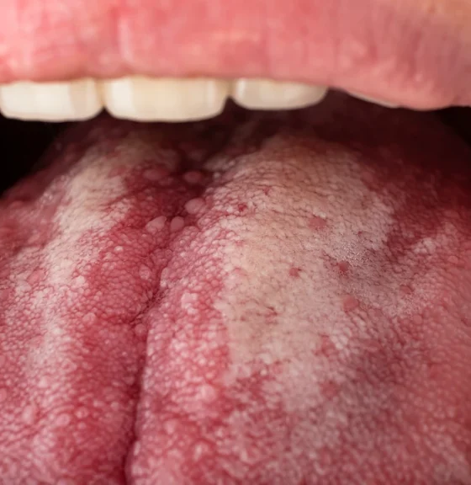
Problem Overview
In the vast landscape of healthcare, there lies a silent enemy known as oral cancer. Its stealthy nature often leads to late detection, resulting in high mortality rates. But fear not, for we embark on a journey to confront this adversary with the power of Artificial Intelligence.
High Cost of Treatment
Oral cancer treatment costs pose financial burdens due to surgeries, radiation, chemotherapy, and post-treatment care expenses.
Late Detection
Late detection of oral cancer is common due to absence of early symptoms and routine screenings.
Traditional Diagnostic Methodology
Conventional detection misses early lesions, necessitating improved methods for timely intervention.
Limited Access to Specialized Healthcare
Limited rural access to oral cancer care delays diagnosis, worsens outcomes; addressing disparities is crucial.
Limited Public Awareness
Public unawareness delays oral cancer diagnosis. Education on risks is crucial for early detection.

Slide 4
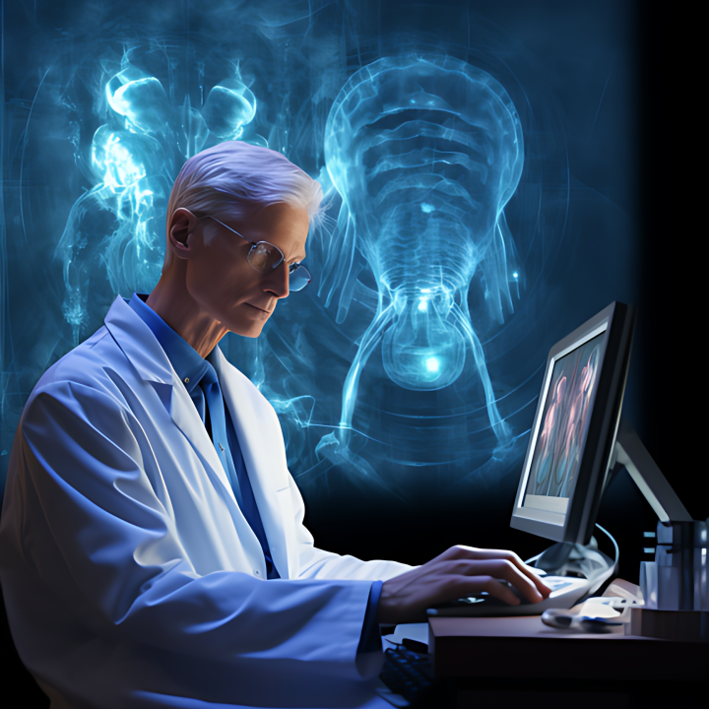
Benefits of AI in Oral Cancer Detection
AI holds great promise in addressing the challenges of oral cancer detection by enabling early, accurate, and objective diagnosis, ultimately leading to improved patient outcomes and enhanced access to healthcare services.
Early Detection
AI detects oral cancer early by analyzing subtle oral tissue changes, enhancing timely intervention and patient outcomes.
Objective Assessment
AI-based tools offer objective oral lesion assessment, reducing bias, improving care quality, and minimizing diagnostic errors.
Improved Accuracy
AI models achieve high accuracy in identifying oral cancer, reducing false positives, unnecessary biopsies, and improving diagnosis efficiency.
Personalized Treatment Planning
AI analyzes patient data to tailor treatment, enhancing outcomes and patient experience through personalized care.

Slide 5
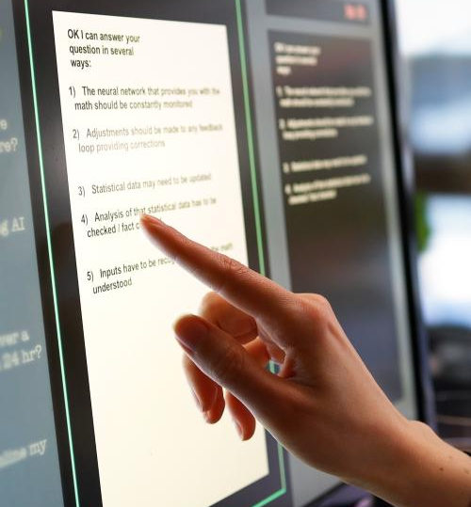
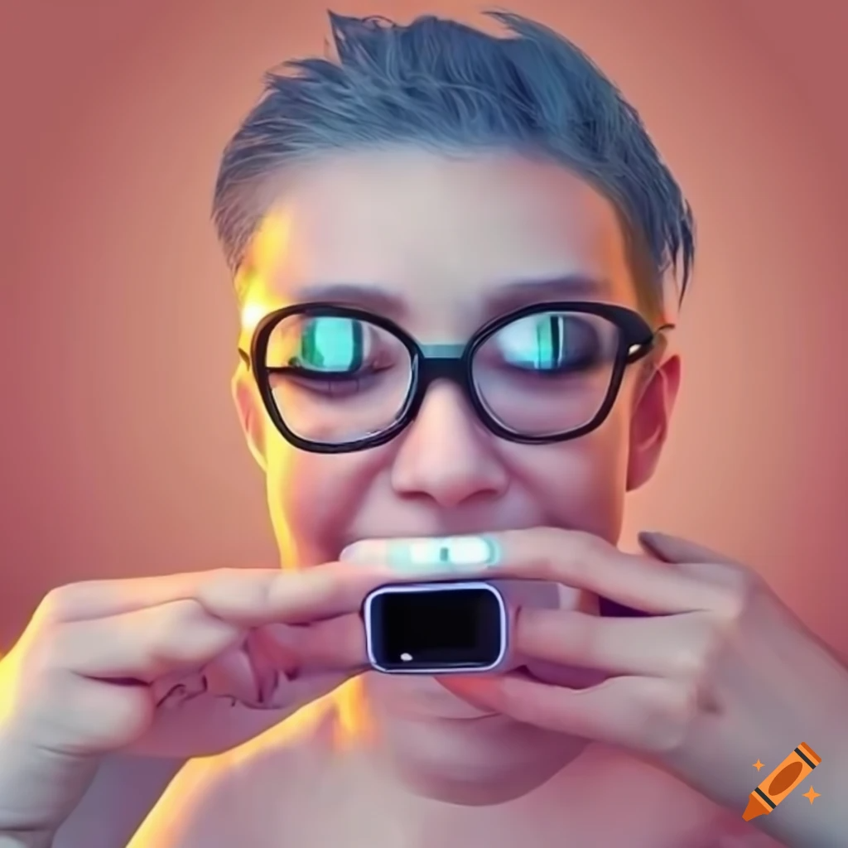
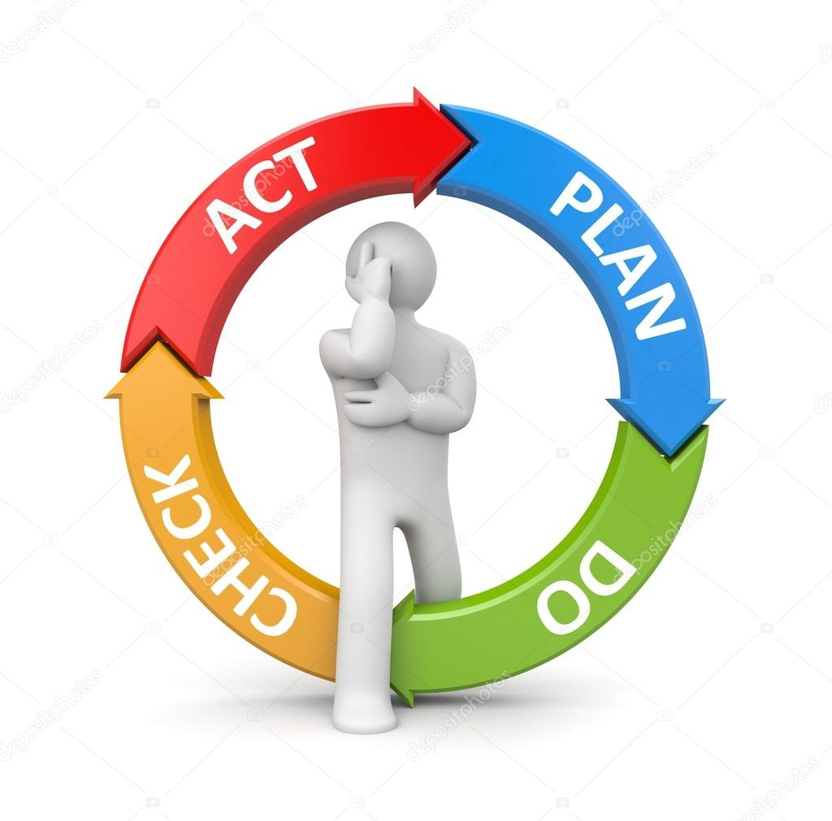
Project goals
Accurate Oral Cancer Detection
Personalized Planning Advice
Develop precise deep learning model for early oral cancer detection from patient images on website.
Website offers personalized advice integrating cancer detection results and health polls, empowering users for oral health.
Interactive Health
AI Polls
Integrate AI-driven polls on website, engaging users with personalized insights on oral health and proactive behaviors.
Notes:
Drag & drop to add a picture in each placeholder

Slide 6
Data Collection
When developing a sophisticated machine learning model like this, achieving high accuracy hinges on having an extensive dataset for training. However, a significant challenge arises when acquiring such a large dataset. How can we surmount this obstacle effectively?
1
Dental organization
collaborate with data organizations and domain experts to obtain diverse and comprehensive data.
2
Data Augmentation
Augmenting your existing dataset by applying transformations such as rotation, flipping, scaling, and changing brightness or contrast can artificially increase the size of your dataset. This helps expose the model to a wider range of variations in the data and improves its generalization capability.
3
Transfer Learning
Utilize pre-trained models that have been trained on a large dataset for a similar task. By fine-tuning these models using your limited dataset, you can leverage the knowledge learned from the larger dataset to improve the performance of your model on the specific task of oral cancer detection.
4
Active Learning
Implement an active learning approach where the model is trained iteratively, and in each iteration, it selects the most informative samples from a pool of unlabeled data for manual annotation. This allows the model to focus on learning from the most relevant and informative instances, thereby maximizing the utility of the limited dataset.

Slide 7

Related Work
OralID
CancerView:
Innovative AI solutions for oral cancer detection, advancing early diagnosis and improving patient outcomes.
AI-integrated oral cancer detection platform, delivering precise diagnostics and personalized treatment recommendations.
DentScan
OralScanTech
Pioneering AI-driven oral cancer detection technology, revolutionizing diagnostic accuracy and treatment planning.
Specializing in AI-based oral cancer screening, offering advanced diagnostic capabilities for improved patient outcomes.
OraCancerAI
CancerDetectPro
Leading provider of AI-powered oral cancer diagnostics, optimizing patient care through innovative technology solutions.
Expert in AI-driven oral cancer detection, providing cutting-edge technology solutions for early diagnosis and treatment planning.

Slide 8
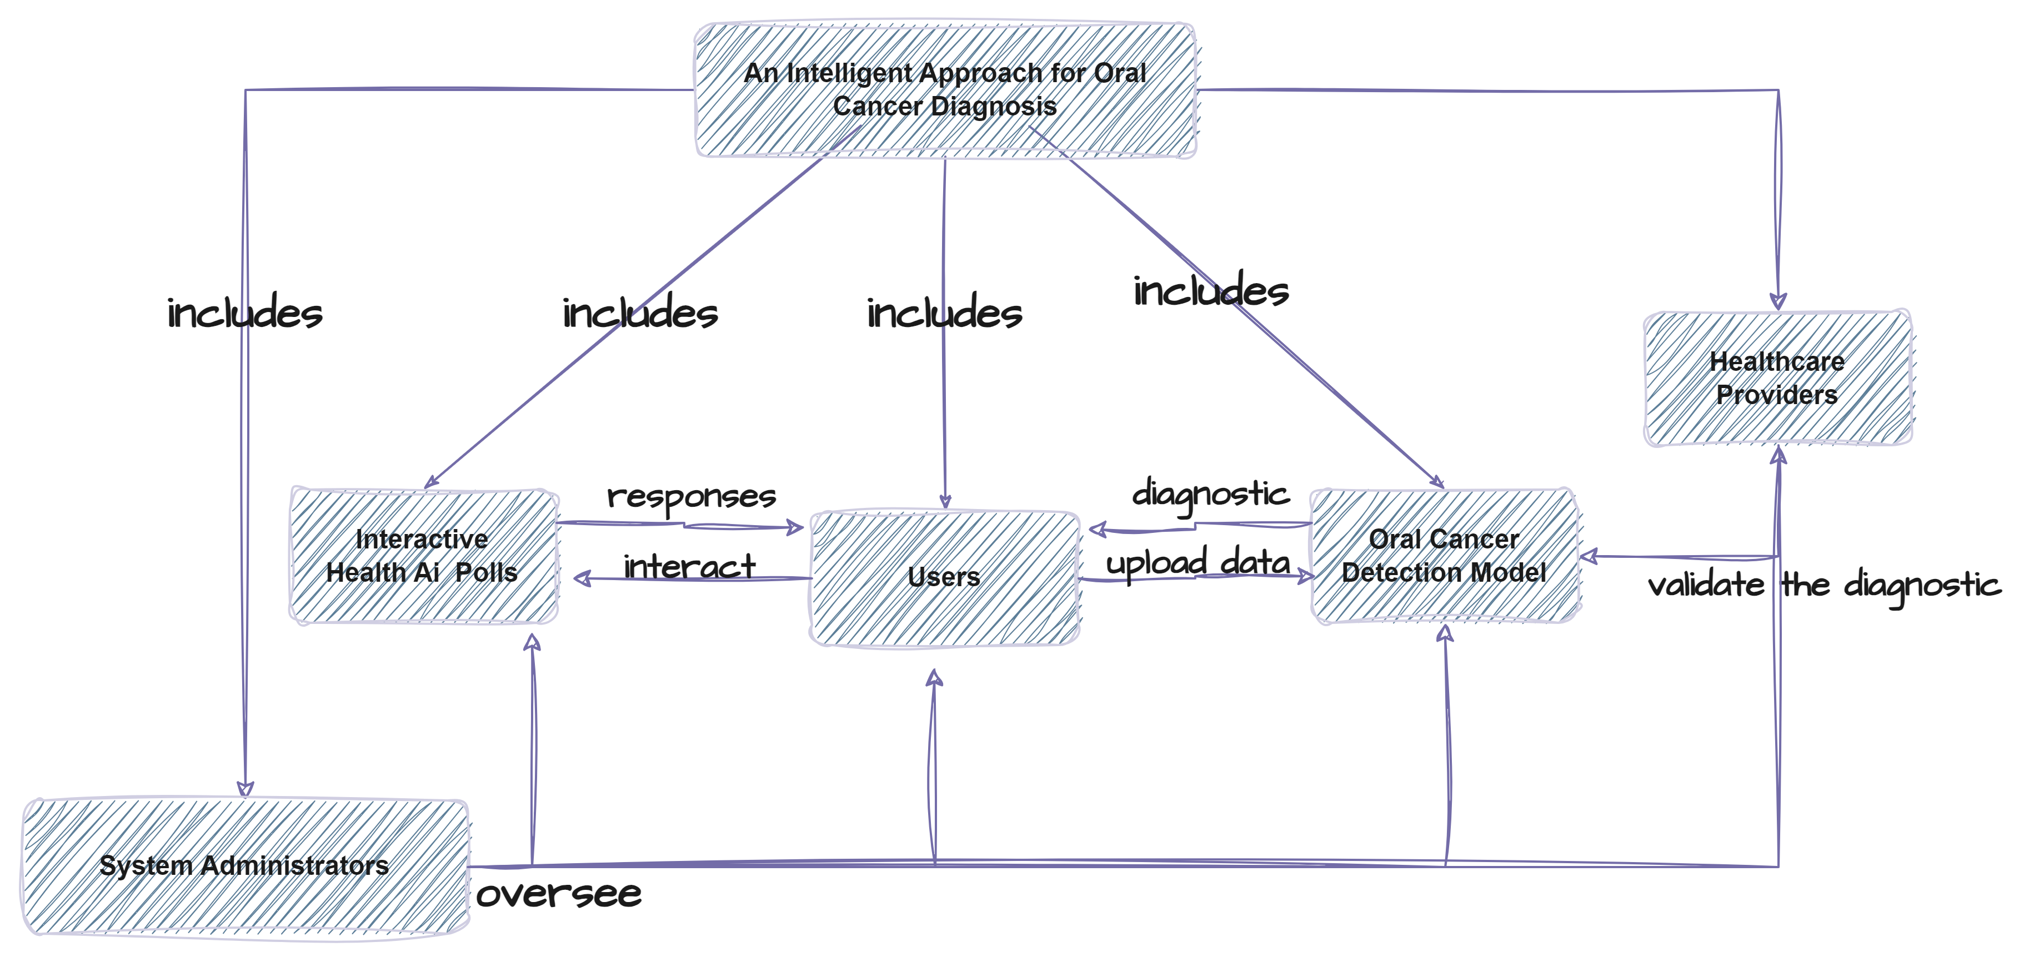
Concept Map
Here's a concept map illustrating the relationships between the components of an intelligent approach for oral cancer diagnosis

Slide 9
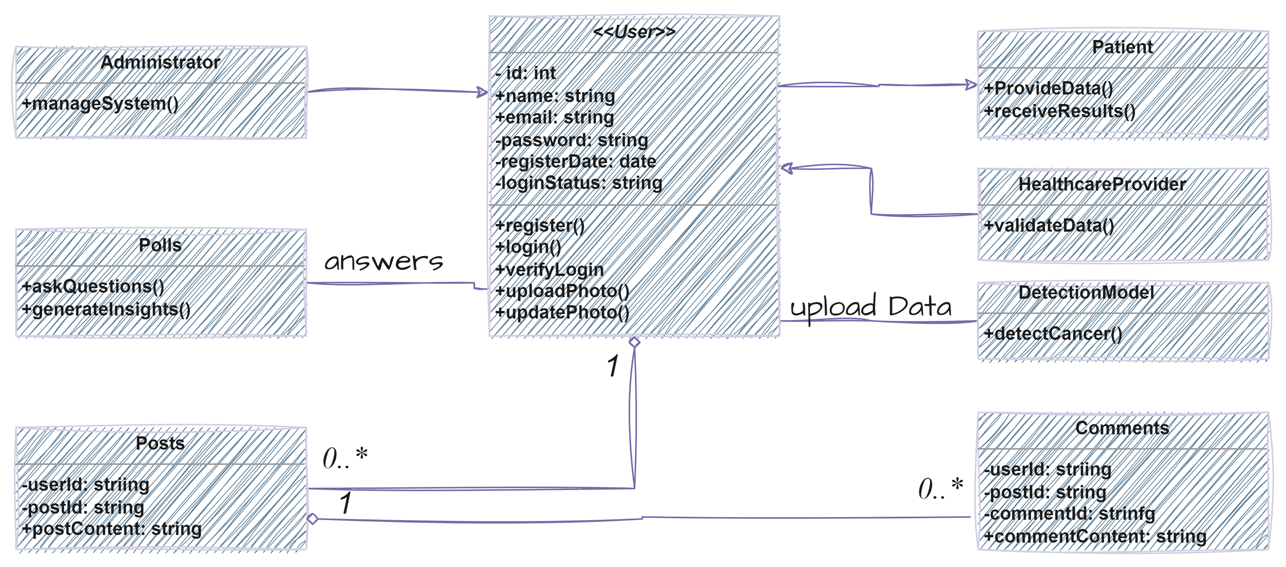
Class Diagram
Here's a class diagram for an Intelligent Approach for Oral Cancer Diagnosis

Slide 10
Used Technologies
Deep Learning Architectures:
Backend
Frameworks like Django or Flask are used for backend development to handle HTTP requests and serve model predictions.
Architectures such as Convolutional Neural Networks (CNNs) or Recurrent Neural Networks (RNNs) are used for image analysis tasks like oral cancer detection.
Machine Learning Frameworks
Frontend
HTML - CSS - JavaScript - React JS
these technologies are used to create the user interface of the website.
TensorFlow, PyTorch, or scikit-learn are commonly used for building and training machine learning models.

Slide 11
Used Technologies
RESTful APIs
Image Processing Libraries
To communicate between the frontend and backend, RESTful APIs are commonly implemented to send data from the website to the backend for processing.
Libraries like OpenCV are used for image preprocessing tasks before feeding images into the AI model.
Web Development Frameworks
Database Management Systems
Frameworks like Django or Flask are used for backend development to handle HTTP requests and serve model predictions.
Systems like MySQL or PostgreSQL are used for storing user data and model predictions.

Slide 12
Time Plan
Insert a subtitle here to describe the content
Train ML Model
Deployment and Launch
Data Collection
Frontend Development
Data Cleaning
Backend Development
Planning & Research
Integration and Testing

Slide 13
Team Members
some team members may have overlapping roles or responsibilities
Ayman Reda
Nada Farouk
Amr Ahmed
Gehad Eltabakh
Project Manager
Backend Developer
Frontend Developer
Backend Developer

Slide 14
Team Members
some team members may have overlapping roles or responsibilities
Abanoub Samy
Mena Alhadidy
BahaaEldein
Azza Ahmed
UI/UX Designer
Frontend Developer
AI/ML Engineer
AI/ML Engineer

Slide 15
Team Members
some team members may have overlapping roles or responsibilities
Hager Naser
MennaTAllah Ahmed
Database Administrator
AI/ML Engineer

Slide 17
THANK
YOU

